Slide 1

Detection of Osteoarthritis using Advance Segmentation in Radiographic Images
Group Members
Urooj Afridi (20P-0192)
Ali Shan Khattak (21P-8046)
Project Supervisor
Dr. Muhammad Amin
muhammad.amin@nu.edu.pk

Slide 2
Introduction
Knee osteoarthritis (OA) is a prevalent joint disease affecting millions globally, leading to pain and reduced mobility.
Current methods for knee osteoarthritis detection from X-ray images are limited.
Our goal is to develop a robust system using deep learning for efficient knee osteoarthritis detection from X-ray images, aiming to enhance patient care.

Slide 3
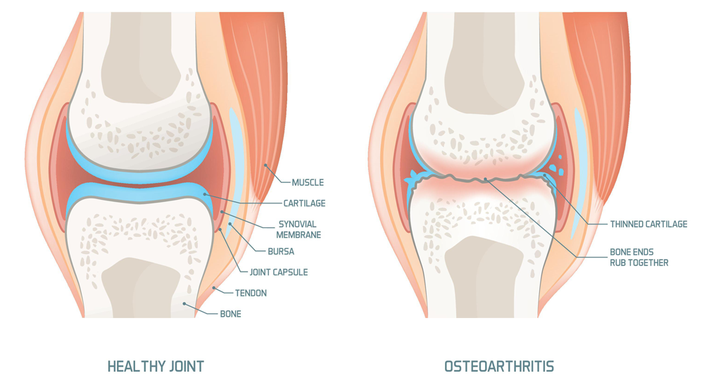
Visual Comparison

Slide 4
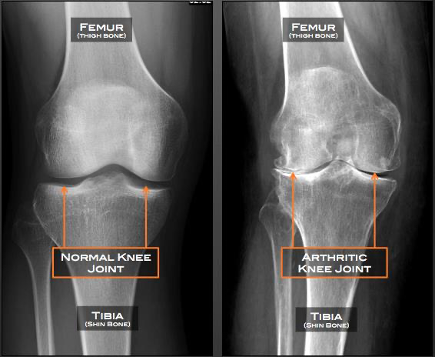
Visual Comparison

Slide 5
Literature Review
Sr | Year | Paper | Techniques | Gap/Limitations
[1] | 2023 | A classification algorithm on improved meta learning & transfer learning for few-shot medical images | It Utilizes ResNet50 pretrained on ImageNet, fine-tuned on public medical data. Applies few-shot learning and improves the classification module with Prototypical Networks. | Data scarcity Limited generalization Evaluation on public datasets
[2] | 2023 | Osteo-NeT | It uses transfer learning with pretrained models, VGG-16 and ResNet-50, alongside data augmentation | Model adaptability to diverse data Biases and inaccuracies Model overfitting

Slide 6
Literature Review ( Continued)
Sr | Year | Paper | Techniques | Gap/Limitations
[3] | 2023 | A ResNet based approach for accurate radiographic diagnosis of knee osteoarthritis | It utilizes various models including VGG and RESNET-50 for knee osteoarthritis classification | Unable to diagnose early stage knee OA No advance segmentation Imbalance data
[4] | 2023 | Medical Image Analysis of Knee Osteoarthritis using Modified Deep CNN | It utilized ResNet 20 to classify knee osteoarthritis grades in a dataset of knee X-ray images | Noise removal and data augmentation Limited analysis of misclassification Data scarcity

Slide 7
Literature Review ( Continued)
Sr | Year | Paper | Techniques | Gap
[5] | 2019 | Knee Osteoarthritis Detection and Severity Classification Using Residual Neural Networks on Preprocessed X-ray Images | It experiments using several pretrained CNN models for KOA classification. | Difficult to be implemented in clinical settings, making it more relevant and valuable for real-world use
[6] | 2019 | Automatic Classification of the Severity of Knee Osteoarthritis Using Enhanced Image Sharpening and CNN | It uses Inception ResNet V2 model used for predicting Knee Osteoarthritis severity | Limited generalization Data bias Model improvement Limited evaluation on specific medical image datasets

Slide 8
Problem Statement
“Accurate detection of osteoarthritis from X-ray images is hindered by challenges posed by previous techniques, emphasizing the necessity for accurate segmentation models tailored to smaller datasets.”

Slide 9
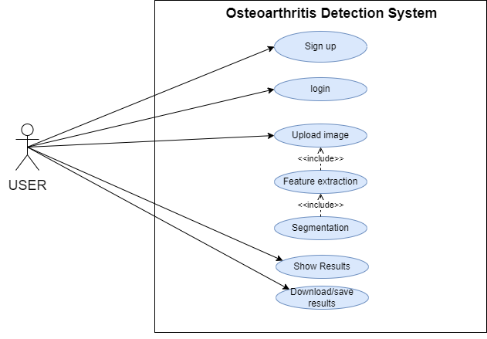
Use Case Diagram
Figure 1.3 Use Case diagram

Slide 10
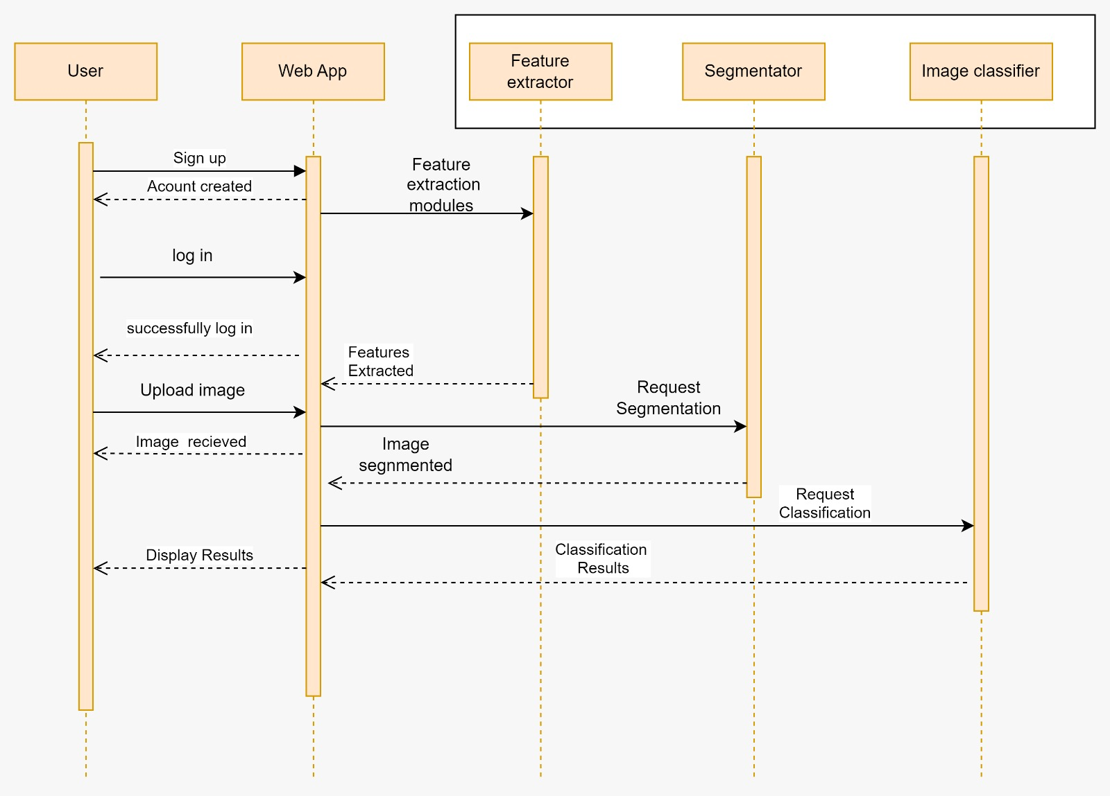
Sequence Diagram
Figure 1.4 Sequence diagram

Slide 11
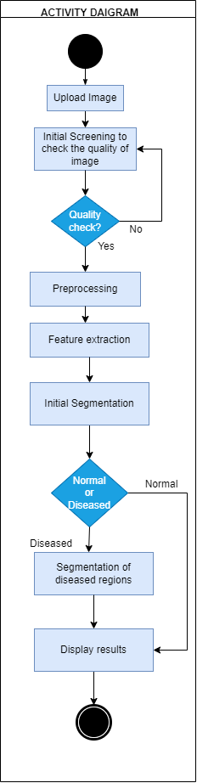
Activity Diagram
Figure 1.5 Activity diagram

Slide 12
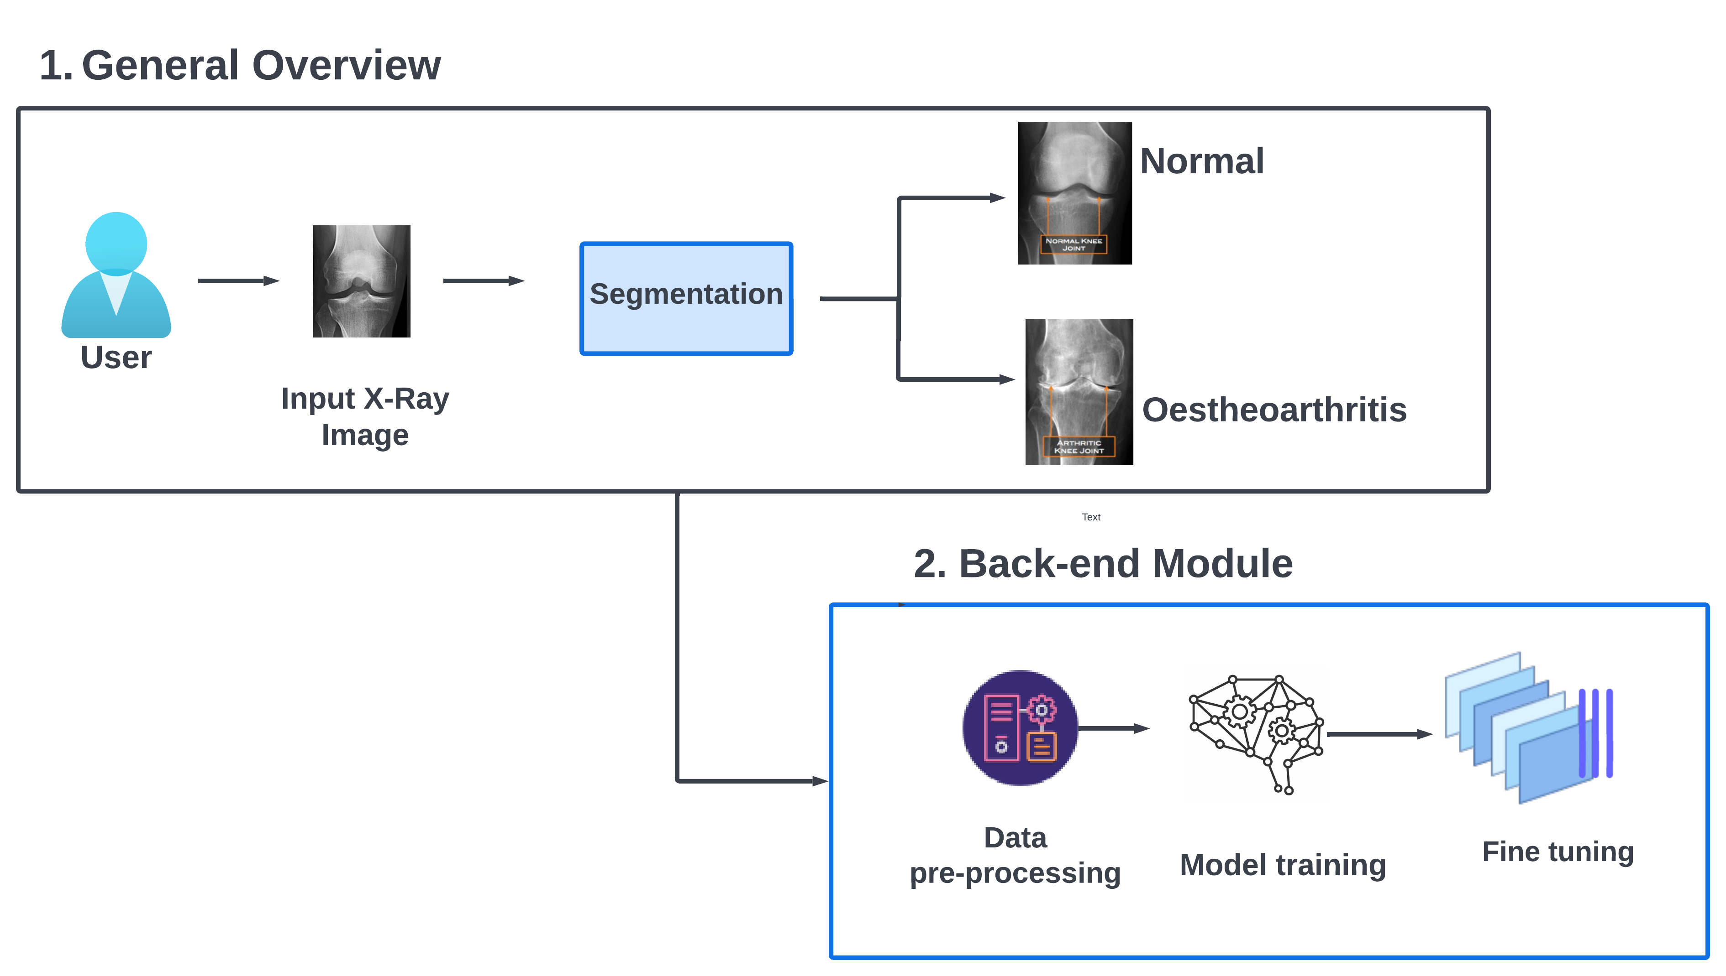
Proposed System
Figure 1.1 Proposed system model

Slide 13
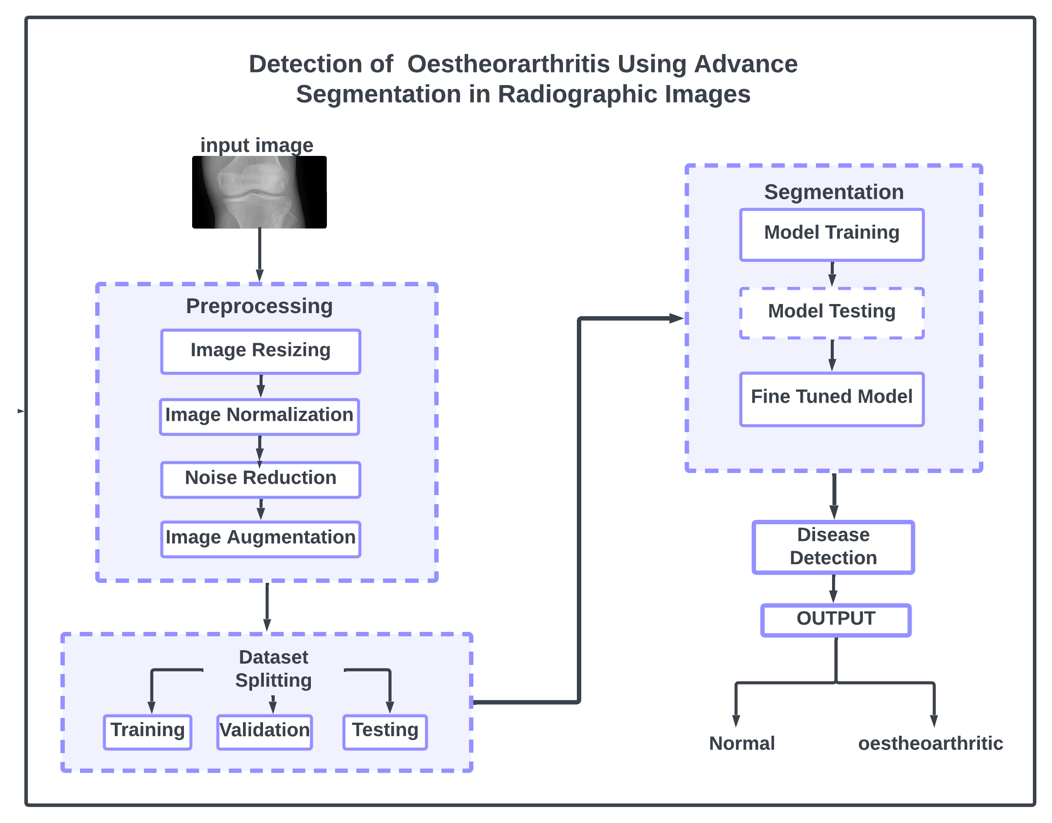
Architecture Diagram
Figure 1.2 Architecture Diagram

Slide 14
Challenges
Data Availability: Limited, unbalanced data for training.
Masks Generation: Creating masks for knee osteoarthritic regions.
Model Complexity: Deep learning models interpretability challenges.
Resource Constraints: Limited access to high-performance computing resources.

Slide 15
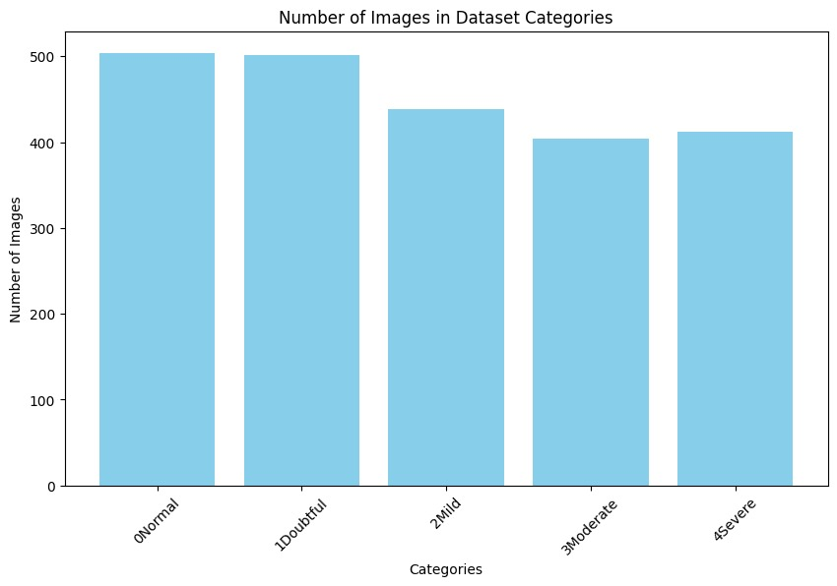
Data statistics
Figure 1.6 Dataset images statistics

Slide 16
Data preprocessing
Resizing
Normalization
Noise reduction
Data Augmentation

Slide 17
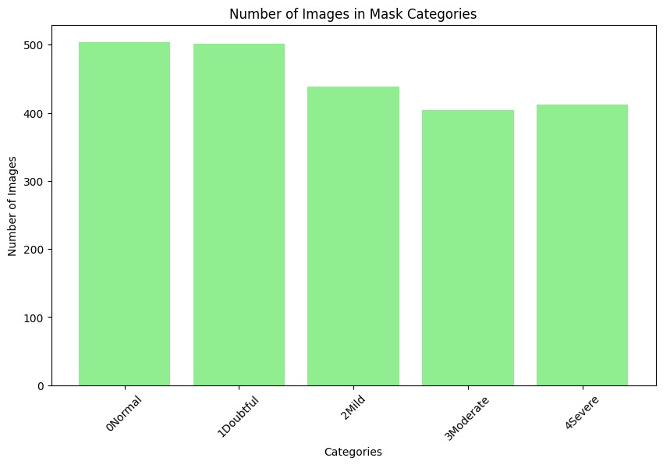
Generating Mask Images:
Applied the Canny edge detection algorithm to each image in the dataset.
Saved the resulting affected area masks, which highlight important edges in the images.
Figure 1.7 Dataset masks statistics

Slide 18
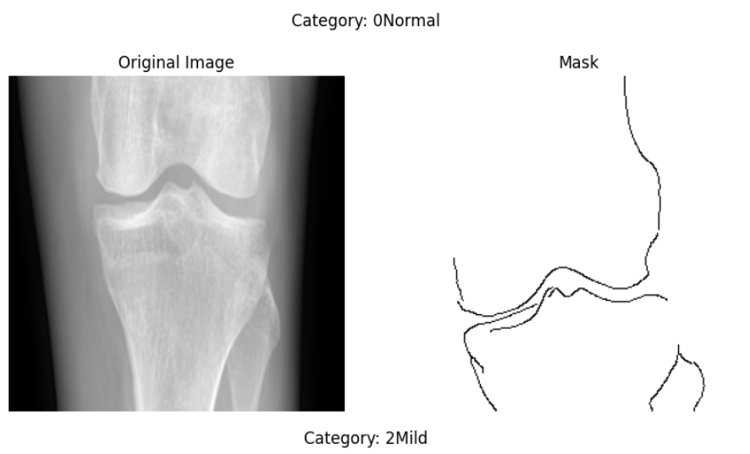
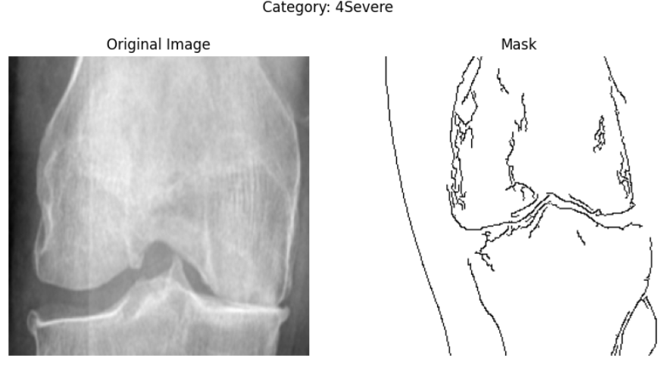
Sample Mask Images:

Slide 19
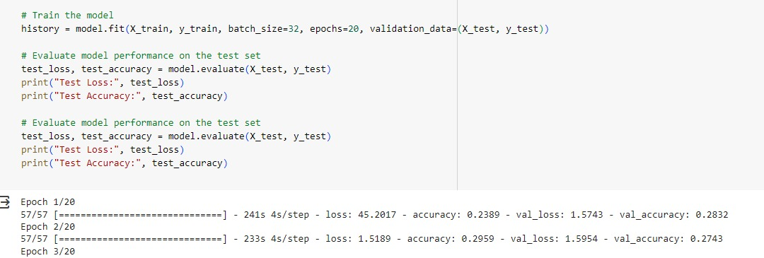
Initial Results:

Slide 20
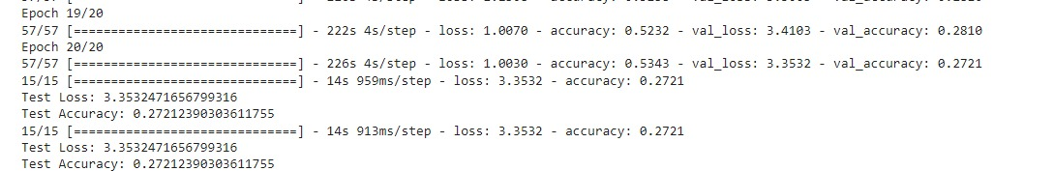
Initial Results:

Slide 21
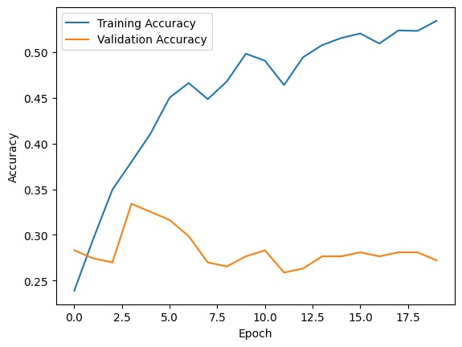
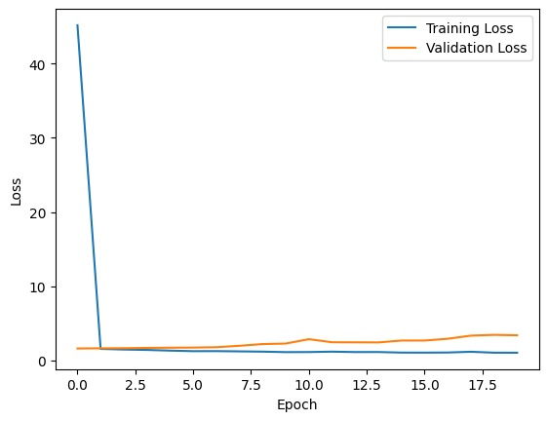
Initial Results:

Slide 22
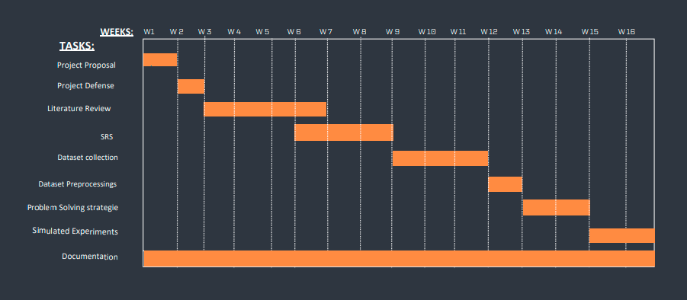
Timeline
Figure 1.5 Gantt Chart for FYP-1

Slide 23
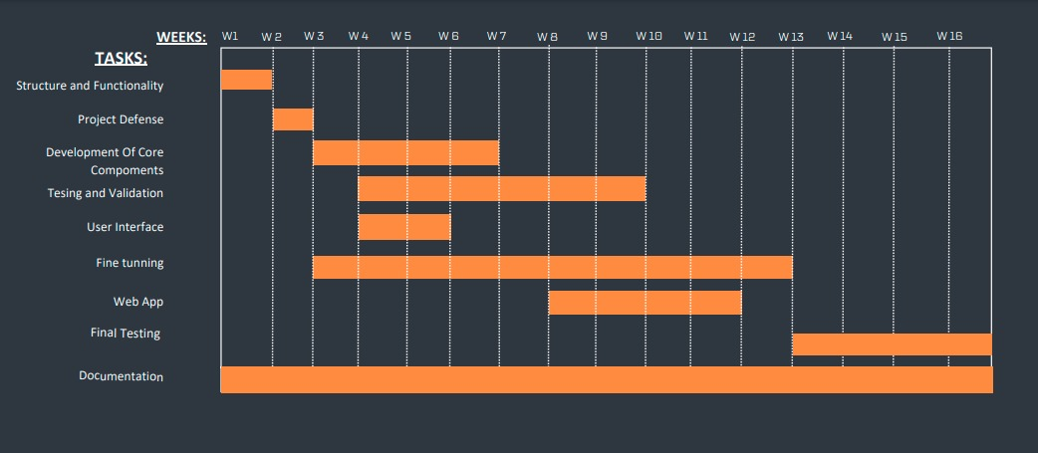
Timeline
Figure 1.6 Gantt Chart for FYP-2

Slide 24
Team Work
Urooj Afridi
Literature review
Proposed model diagram
Architecture Diagram
Dataset Collection
Model selection & training
Web application
Report
Alishan Khattak
Literature review
Activity diagram
Sequence diagram
Use case diagram
Dataset Collection
Model selection & training
Web application
Report

Slide 25
References
Zhang, B., Gao, B., Liang, S., Li, X., & Wang, H. (2023). A classification algorithm based on improved meta learning and transfer learning for few‐shot medical images. IET Image Processing.
Alshamrani, H. A., Rashid, M., Alshamrani, S. S., & Alshehri, A. H. (2023, April). Osteo-NeT: An Automated System for Predicting Knee Osteoarthritis from X-ray Images Using Transfer-Learning-Based Neural Networks Approach. In Healthcare (Vol. 11, No. 9, p. 1206). MDPI.
Wang, Y., Li, S., Zhao, B., Zhang, J., Yang, Y., & Li, B. (2022). A ResNet‐based approach for accurate radiographic diagnosis of knee osteoarthritis. CAAI Transactions on Intelligence Technology, 7(3), 512-521.
Bellary, M. Z., Deepthi, T. H. S., Musthafa, B. A., Ahmed, S. J., & Sarkar, R. (2023). Medical Image Analysis of Knee Osteoarthritis using Modified Deep CNN. Journal of Survey in Fisheries Sciences, 10(2S), 133-144.
Lu, Y., Li, W., Zheng, K., Wang, Y., Harrison, A. P., Lin, C., ... & Miao, S. (2020). Learning to segment anatomical structures accurately from one exemplar. In Medical Image Computing and Computer Assisted Intervention–MICCAI 2020: 23rd International Conference, Lima, Peru, October 4–8, 2020, Proceedings, Part I 23 (pp. 678-688). Springer International Publishing.
Goswami, A. D. (2023). Automatic classification of the severity of knee osteoarthritis using enhanced image sharpening and CNN. Applied Sciences, 13(3), 1658.
Moon, K. R., Lee, B. D., & Lee, M. S. (2023). A deep learning approach for fully automated measurements of lower extremity alignment in radiographic images. Scientific Reports, 13(1), 14692.
Mohammed, A. S., Hasanaath, A. A., Latif, G., & Bashar, A. (2023). Knee Osteoarthritis Detection and Severity Classification Using Residual Neural Networks on Preprocessed X-ray Images. Diagnostics, 13(8), 1380.
Tariq, T., Suhail, Z., \& Nawaz, Z. (2023). Knee osteoarthritis detection and classification using x-rays. IEEE Access.
Dam, E. B., Lillholm, M., Marques, J., \& Nielsen, M. (2015). Automatic segmentation of high-and low-field knee MRIs using knee image quantification with data from the osteoarthritis initiative. Journal of Medical imaging, 2(2), 024001-024001.

Slide 26
References
Bhat, A. Y., & Normal, A. S. (2019). Abnormal Detection For Knee Osteoarthritis Using Machine Learning Techniques. Int. J. Recent Technol. Eng, 8, 6026-6033.
Liu, B., Luo, J., & Huang, H. (2020). Toward automatic quantification of knee osteoarthritis severity using improved Faster R-CNN. International journal of computer assisted radiology and surgery, 15, 457-466.
[5] Prezja, F., Paloneva, J., Pölönen, I., Niinimäki, E., \& Äyrämö, S. (2022). DeepFake knee osteoarthritis X-rays from generative adversarial neural networks deceive medical experts and offer augmentation potential to automatic classification. Scientific Reports, 12(1), 18573.
[12] Kim, Y. J., Lee, S. R., Choi, J. Y., \& Kim, K. G. (2021). Using Convolutional Neural Network with Taguchi Parametric Optimization for Knee Segmentation from X-ray Images. BioMed Research International, 2021.
Ronneberger, O., Fischer, P., \& Brox, T. (2015). U-net: Convolutional networks for biomedical image segmentation. In Medical image computing and computer-assisted intervention–MICCAI 2015: 18th international conference, Munich, Germany, October 5-9, 2015, proceedings, part III 18 (pp. 234-241). Springer International Publishing.
Abd El-Ghany, S., Elmogy, M., & Abd El-Aziz, A. A. (2023). A fully automatic fine tuned deep learning model for knee osteoarthritis detection and progression analysis. Egyptian Informatics Journal, 24(2), 229-240.
Abd El-Ghany, S., Elmogy, M., \& Abd El-Aziz, A. A. (2023). A fully automatic fine tuned deep learning model for knee osteoarthritis detection and progression analysis. Egyptian Informatics Journal, 24(2), 229-240.
Ibtehaz, N., \& Rahman, M. S. (2020). MultiResUNet: Rethinking the U-Net architecture for multimodal biomedical image segmentation. Neural networks, 121, 74-87.
Ahmed, S. M., \& Mstafa, R. J. (2022). A comprehensive survey on bone segmentation techniques in knee osteoarthritis research: From conventional methods to deep learning. Diagnostics, 12(3), 611.
Antony, J., McGuinness, K., Moran, K., \& O’Connor, N. E. (2017). Automatic detection of knee joints and quantification of knee osteoarthritis severity using convolutional neural networks. In Machine Learning and Data Mining in Pattern Recognition: 13th International Conference, MLDM 2017, New York, NY, USA, July 15-20, 2017, Proceedings 13 (pp. 376-390). Springer International Publishing.
Gornale, S. (2020, June 23). Digital Knee X-ray images. Mendeley Data. https://data.mendeley.com/datasets/t9ndx37v5h/1

Slide 27
Thank You

